Slide 1
Introduction to Data Structure
SESSION 02
Henry Lucky, S.Kom., M.Kom.

Slide 2
LEARNING OUTCOMES
Session 02
The learning outcomes associated with this topic:
LO 1: Explain the concept of data structures and its usage in Computer Science

Slide 3
LEARNING Objectives
Session 02
At the end of this session, students will be able to:
Understand the concept of Abstract Data Type and Data Structure
Explain the types of Data Structures (Array, Linked List, Stack, Queue, Binary Trees)
Apply the Struct concept using C

Slide 4
SUBTOPICS
Session 02
Abstract Data Type
Struct
Nested Struct
Data Structures
Type of Data Structures

Slide 5
Abstract data type
Data type
Data Type is a collection of objects and a set of operations that act on those objects.
For example, the data type int consists of:
Objects : 0, 1, -1, 2, -2, etc
Operations : +, -, *, /, %, etc
Example of predefined data types are int, char, float.

Slide 6
Abstract data type
concept
Abstract Data Type (ADT) is an example of user-defined data types.
ADT is a collection of objects and a set of operations that act on those objects.
C/C++ has a concept called class and struct which assist the programmer in implementing abstract data type.
The implementation view of an ADT is called a data structure.

Slide 7
struct
concept
Structure is basically a user-defined data type that can store related information (even of different data types) together, while an array can store only entities of same data types.
It is a collection of variables under a single name.
The variables within a structure are of different data types and each has a name that is used to select it from the structure.

Slide 8
struct
declaration

Slide 9
struct
declaration
The code here defines a structure named tdata which has three members: age (int), name (char[]) and score (float).
Creating a variable of structure is similar to create a variable of primitive data type.
tdata x;// a variable of tdata
tdata arr[100];// an array of tdata

Slide 10
struct
declaration
You also can define a structure as well as declare variables.

Slide 11
Struct
assignments
You can use operator . (dot) to access member of x.

Slide 12
Nested Struct
assignments
You can have a struct as a member of another struct.

Slide 13
Data structure
concept
A data structure is an arrangement of data, either in the computer’s memory or on the disk storage.
Some common examples of data structures include:
Arrays
Linked lists
Queues
Stacks
Binary trees
Hash tables

Slide 14
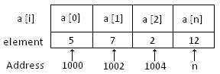
Types of Data structure
array
A collection of similar data elements
Data elements have the same data type

Slide 15
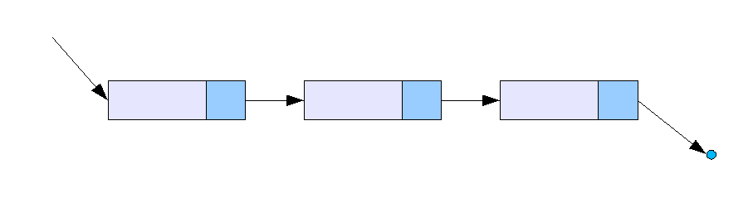
Types of Data structure
Linked list
A very dynamic data structure in which the elements can be added to or deleted from anywhere at will
Each element is called a node

Slide 16
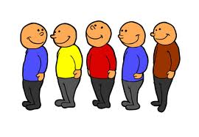
Types of Data structure
queue
The element that was inserted first is the first one to be taken out
The elements in a queue are added at one end called the rear and removed from the other end called the front

Slide 17
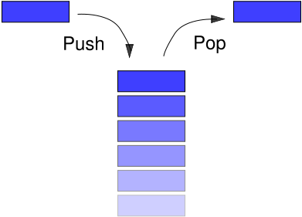
Types of Data structure
stack
Stacks can be represented as a linear array
Every stack has a variable TOP associated with it
LIFO (Last In First Out) / FILO (First In Last Out)

Slide 18
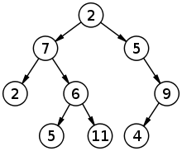
Types of Data structure
Binary tree
A data structure which is defined as a collection of elements called the nodes
Every node contains a left pointer, a right pointer, and a data element

Slide 19
References
S. Sridhar. 2015. Design and Analysis of Algorithms. Oxford University Press. New Delhi. ISBN: 9780198093695. Chapter 5
Reema Thareja. 2014. Data structures using C. Oxford University Press. New Delhi. ISBN:9780198099307. Chapter 1, 2, 3, & 5
Arrays in C/C++ Programming, http://www.mycplus.com/tutorials/data-structures/arrays-c-cpp-programming
Structures In C, http://www.asic-world.com/scripting/structs_c.html

